Slide 1


Presented by HEXA_Group

Slide 2








Slide 3












Slide 4



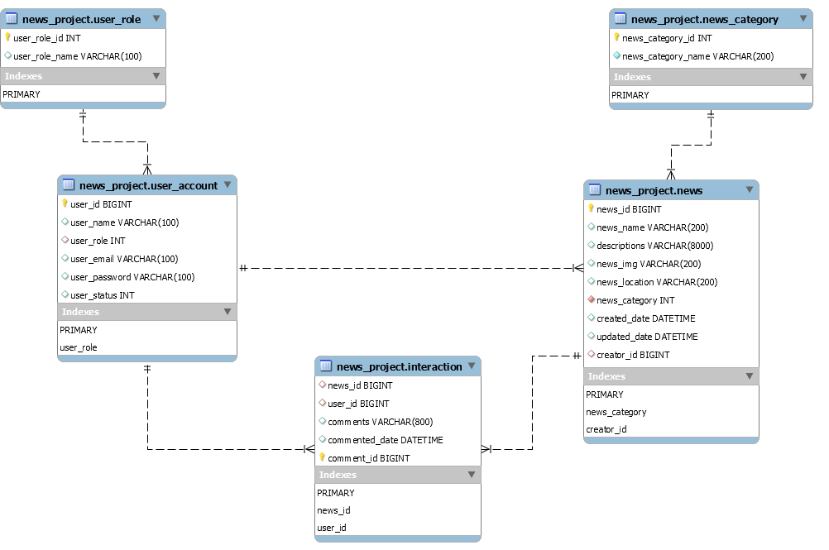




Slide 5
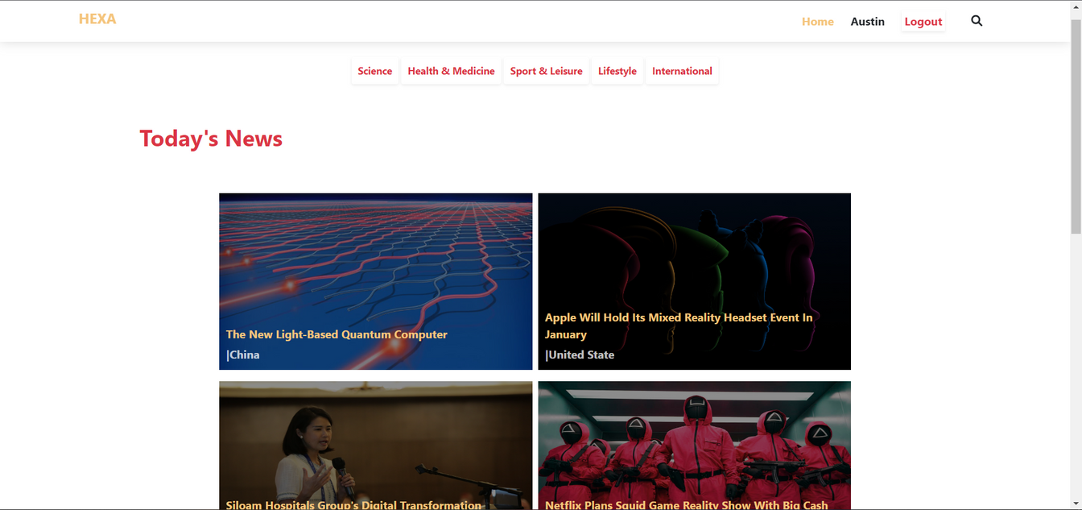
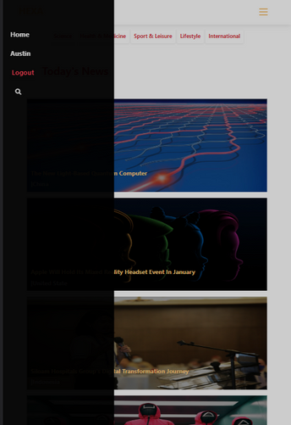



Slide 6

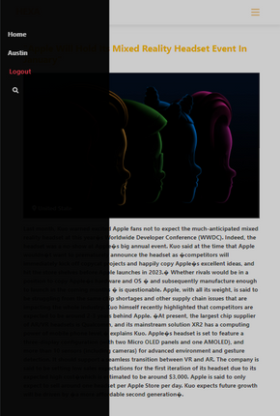

Slide 7
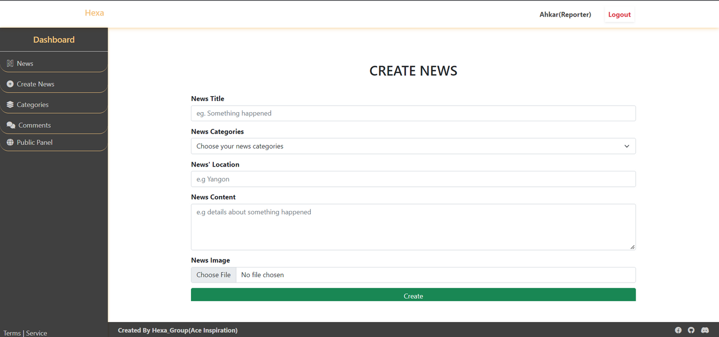
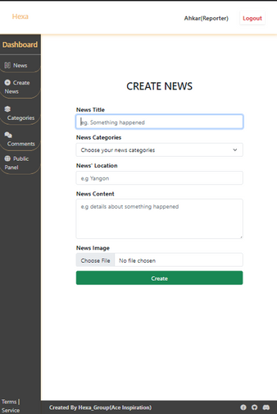

Slide 8
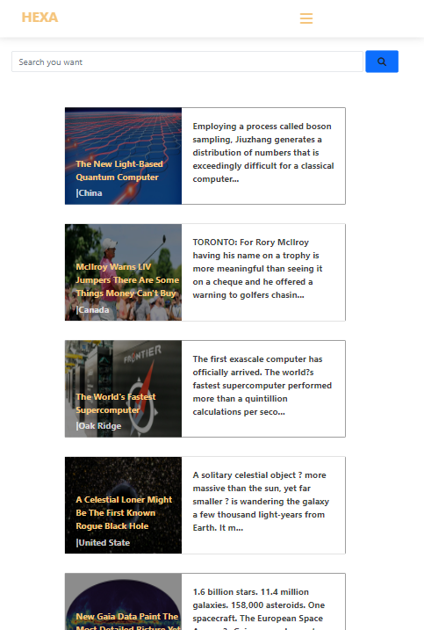

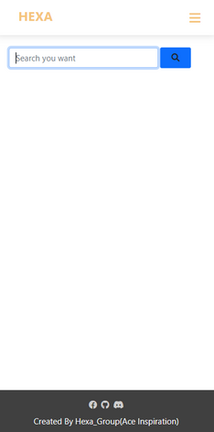

Slide 9
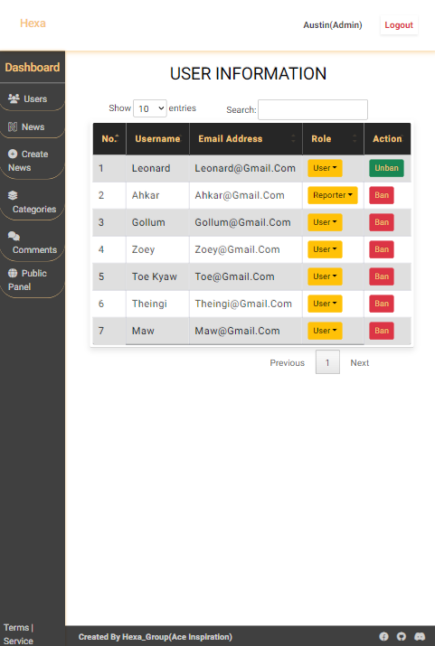

Slide 10



Address
Thank you
For Your Attention
Yangon, Burma.
Email
hexa_group@gmail.com
Social Media
https://github.com/hexa_news-group_project.git

